Slide 1
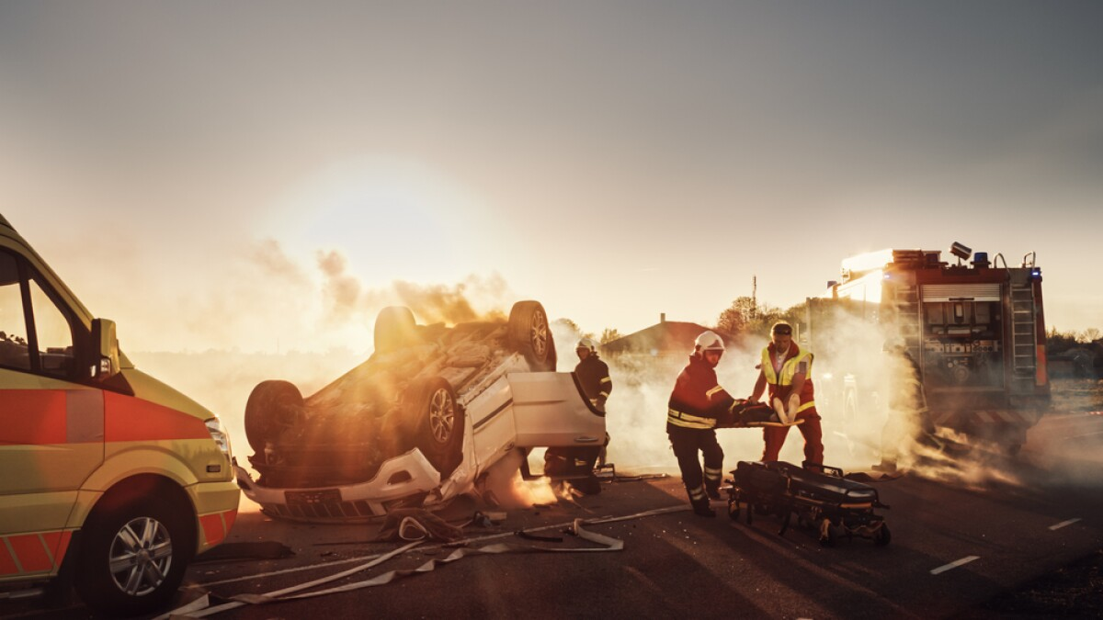
Road Crashes
Suyes Sapokta, Ruman Dangal, Sai Sree Korrapati

Slide 2
THE ROADMAP
Introduction
Modules
Schema Diagram
Description
Axioms
All Together
Competency Questions
SPARQL Queries
Execution Demo
Retrospective

Slide 3
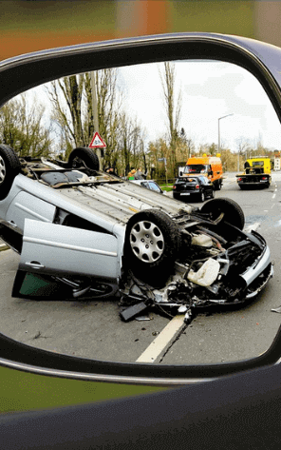
INTRODUCTION
The Problem: Every year, road crashes claim over 1.35 million lives globally and leave millions injured. These crashes cause significant financial, emotional, and societal impacts.
Key Challenges: Understanding and preventing road crashes is difficult because they result from multiple interacting factors, such as:
Driver conditions (e.g., impairments, distractions).
Vehicle conditions (e.g., safety features).
Road conditions (e.g., surface).
Weather and environmental factors (e.g., rain, snow).
Traditional approaches often fail to capture the relationships between these factors, making it harder to predict and prevent crashes.
Why Build a Knowledge Graph: A Knowledge Graph (KG) provides a semantic framework that links crash-related data from various sources. It can:
Capture complex relationships between drivers, vehicles, roads, and environments.
Identify hidden patterns and high-risk areas.
Enable smarter interventions and policies to improve road safety.

Slide 4
MODULES

Slide 5
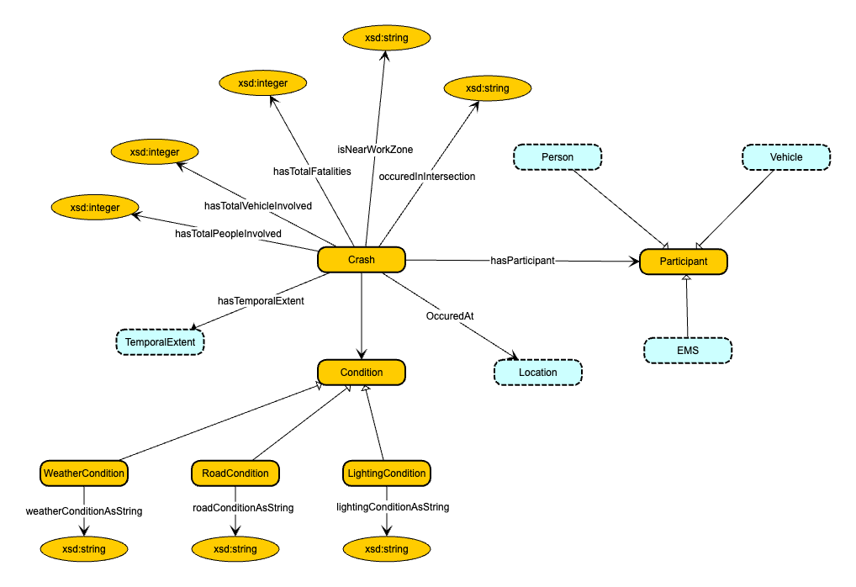
CRASH
The Crash module acts as the central entity of the Knowledge Graph, capturing essential details of crash events. It includes attributes such as the total number of vehicles, participants, fatalities, and injuries. Additionally, it incorporates connections to related modules like location, time, participants (drivers, passengers, pedestrians), road conditions, and EMS response. This module is key to understanding the overall context, cause, and severity of a crash.

Slide 6
CRASH AXIOMS

Slide 7
Manchester Syntax | Natural Language Description
owl:Thing SubClassOf hasTemporalExtent only TemporalExtent | The range of the property hasTemporalExtent must belong to the class TemporalExtent.
Crash SubClassOf hasTemporalExtent exactly 1 TemporalExtent | Every Crash must have exactly one associated temporal extent.
Crash SubClassOf occurredAt only Location | The range of the property occurredAt must belong to the class Location.
Crash SubClassOf occurredAt exactly 1 Location | Every Crash must occur at exactly one location.
Crash SubClassOf hasTotalFatalities only xsd:integer | The range of the property hasTotalFatalities must be an integer.
Crash SubClassOf hasTotalFatalities min 0 xsd:integer | Every Crash may have an associated integer value representing total fatalities
Crash SubClassOf hasTotalPeopleInvolved only xsd:integer | The range of the property hasTotalPeopleInvolved must be an integer.
Crash SubClassOf hasTotalPeopleInvolved some xsd:integer | Every Crash must have an associated integer value representing total people involved.
Crash SubClassOf hasTotalVehiclesInvolved only xsd:integer | The range of the property hasTotalVehiclesInvolved must be an integer.
Crash SubClassOf hasTotalVehiclesInvolved some xsd:integer | Every Crash must have an associated integer value representing total vehicles.
Crash SubClassOf hasParticipant only Participant | The range of the property hasParticipant must belong to the class Participant.
Crash SubClassOf hasParticipant some Participant | Every Crash must have at least one associated Participant.
Crash SubClassOf isNearWorkZone only xsd:string | The value of the property isNearWorkZone must be a string.
Crash SubClassOf isNearWorkZone some xsd:string | Crash must have atleast one isNearWorkZone and it must be a string.
Crash SubClassOf occurredInIntersection only xsd:string | The value of the property occurredInIntersection must be a string.
Crash SubClassOf occurredInIntersection some xsd:string | Crash must have atleast one occurredInIntersection and it must be a string.
Crash SubClassOf hasCondition only Condition | The condition of any Crash must be of type Condition.
Crash SubClassOf hasCondition some Condition | Every Crash must have at least one Condition.
WeatherCondition SubClassOf Condition | Every weather condition is Condition.
WeatherCondition SubClassOf weatherConditionAsString only xsd:string | WeatherCondition may have weatherConditionAsString, if it does it must be a string.
WeatherCondition SubClassOf weatherConditionAsString some xsd:string | WeatherCondition must have atleast one weatherConditionAsString and it must be a string.
RoadCondition SubClassOf Condition | Every Road condition is Condition.
RoadCondition SubClassOf roadConditionAsString only xsd:string | RoadCondition may have roadConditionAsString, if it does it must be a string.
RoadCondition SubClassOf roadConditionAsString some xsd:string | RoadCondition must have atleast one roadConditionAsString and it must be a string.
LightingCondition SubClassOf Condition | Every LightingCondition is Condition.
LightingCondition SubClassOf lightingConditionAsString only xsd:string | LightingCondition may have LightingConditionAsString, if it does it must be a string.
LightingCondition SubClassOf lightingConditionAsString some xsd:string | LightingCondition must have atleast one LightingConditionAsString and it must be a string.

Slide 8
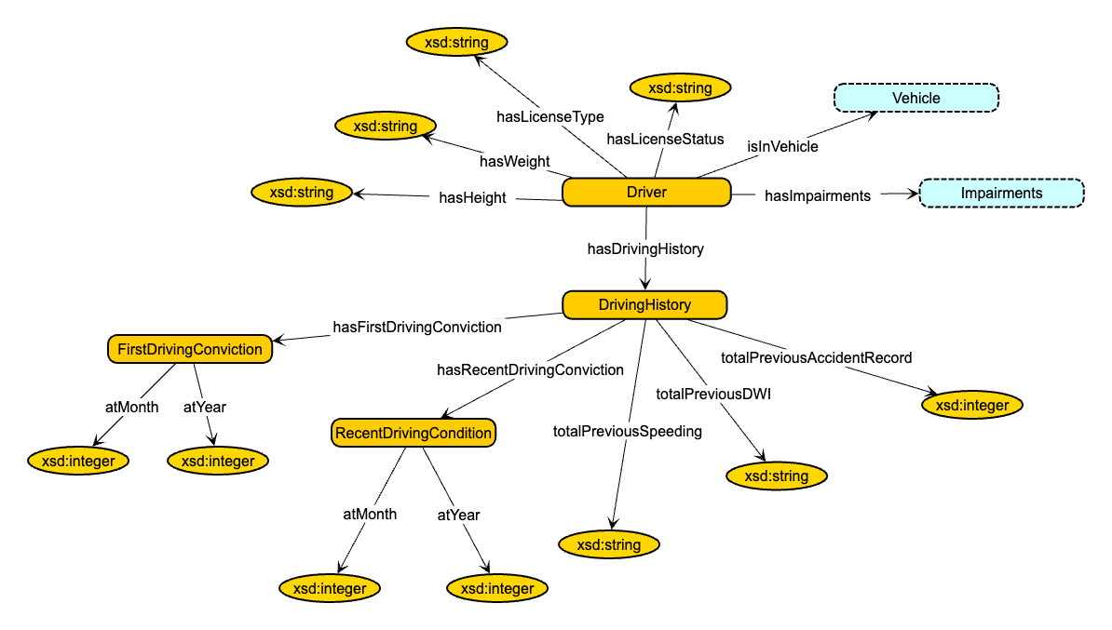
DRIVER
The Driver module captures attributes and behaviors of drivers involved in crashes. This includes driving history (e.g., prior offenses such as speeding or DUI), impairments (e.g., alcohol, drugs, or distractions), and demographic information like height and weight. The module connects drivers to vehicles and examines their influence on crash outcomes, providing insights into high-risk behaviors.

Slide 9
DRIVER AXIOMS

Slide 10
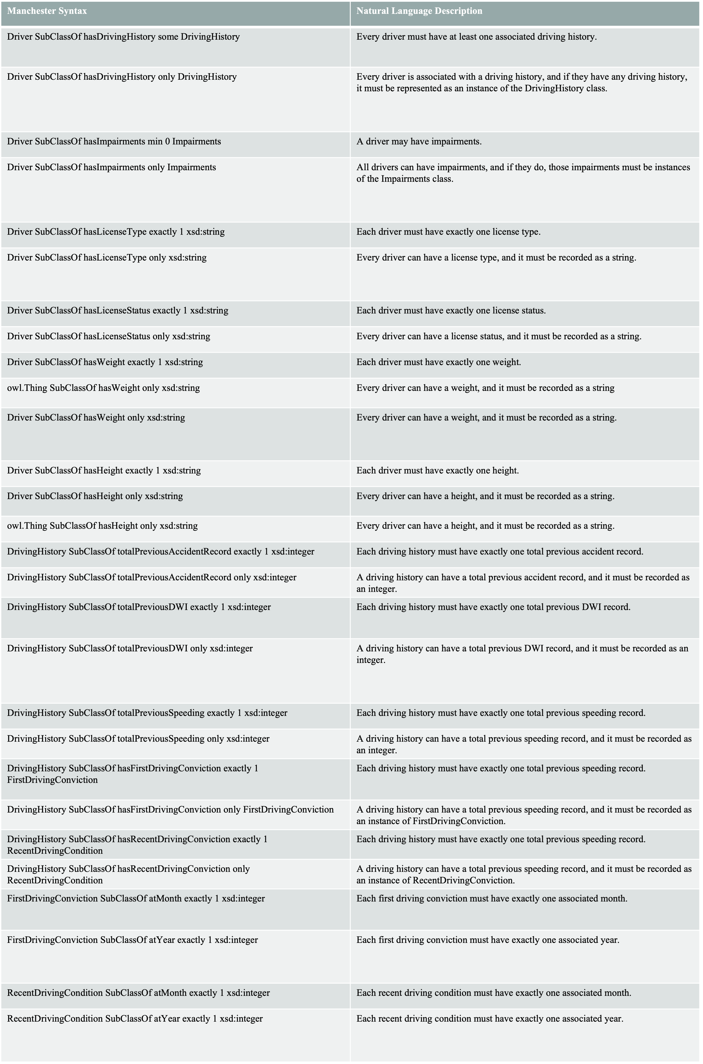

Slide 11
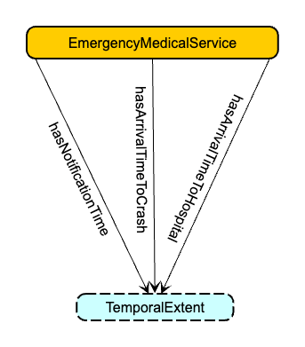
EMS
The EMS module tracks emergency response timelines, from crash notification to medical treatment. It evaluates how response and transport delays affect survival rates and overall crash outcomes.

Slide 12
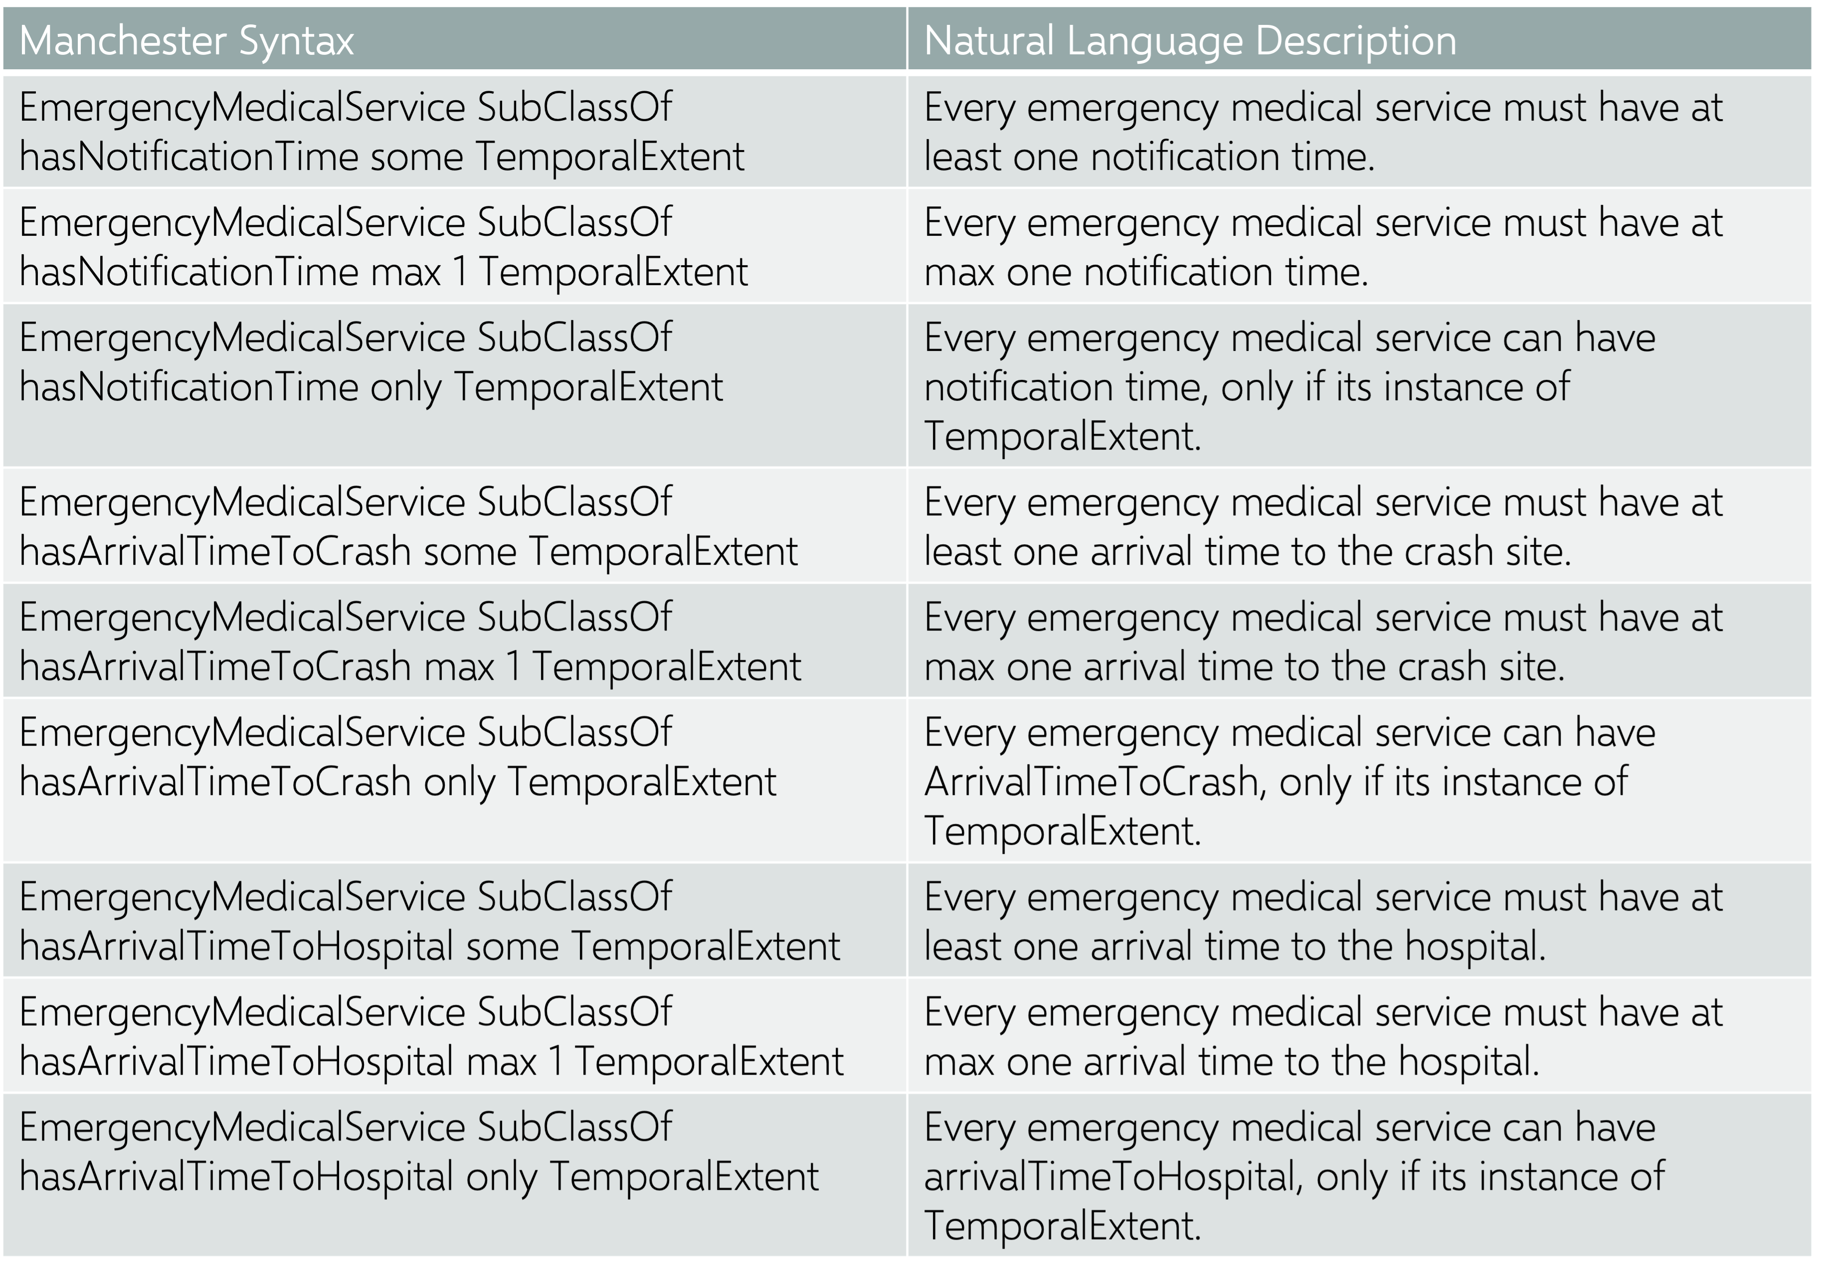
AXIOMS

Slide 13
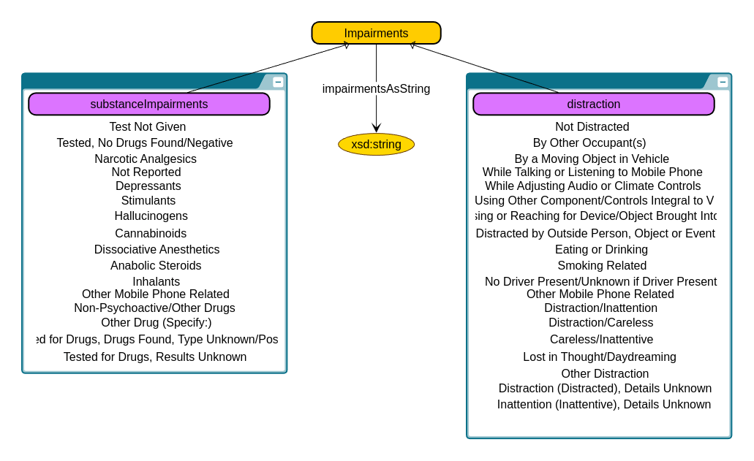
IMPAIRMENTS
This module focuses on driver impairments such as fatigue, alcohol or drug use, and distractions. It explores how these impairments contribute to crash risks, supporting targeted safety measures.

Slide 14
AXIOMS
Manchester Syntax | Natural Language Description
Impairments SubClassOf impairmentsAsString exactly 1 xsd:string | Each impairment can have exactly one associated string description.
SubstanceImpairments SubClassOf Impairments | Every SubstanceImpairments are Impairments.
Distraction SubClassOf Impairments | Every Distractions are Impairment.
SubstanceImpairments SubClassOf substanceImpairmentAsString exactly 1 xsd:string | Each SubstanceImpairments can have exactly one associated string description
SubstanceImpairments SubClassOf substanceImpairmentAsString only xsd:string | Each SubstanceImpairments mmay have exactly description, if it does, it must be in string.
Distraction SubClassOf distractionAsString exactly 1 xsd:string | Each Distraction can have exactly one associated string description
Distraction SubClassOf distractionAsString only xsd:string | Each Distraction may have description, if it does, it must be in string.

Slide 15
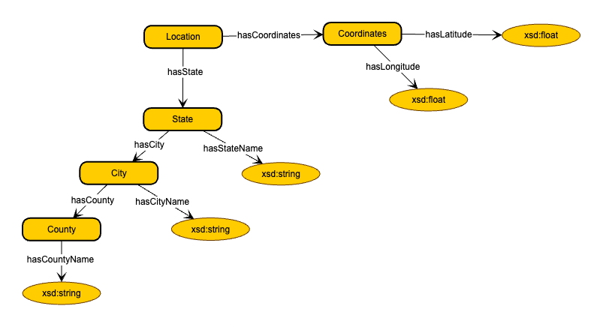
LOCATION
The Location module captures geographic details of crash occurrences, linking events to regions, states, and specific coordinates. This allows for spatial analysis to identify high-risk areas and examine location-based influences on crash patterns.

Slide 16
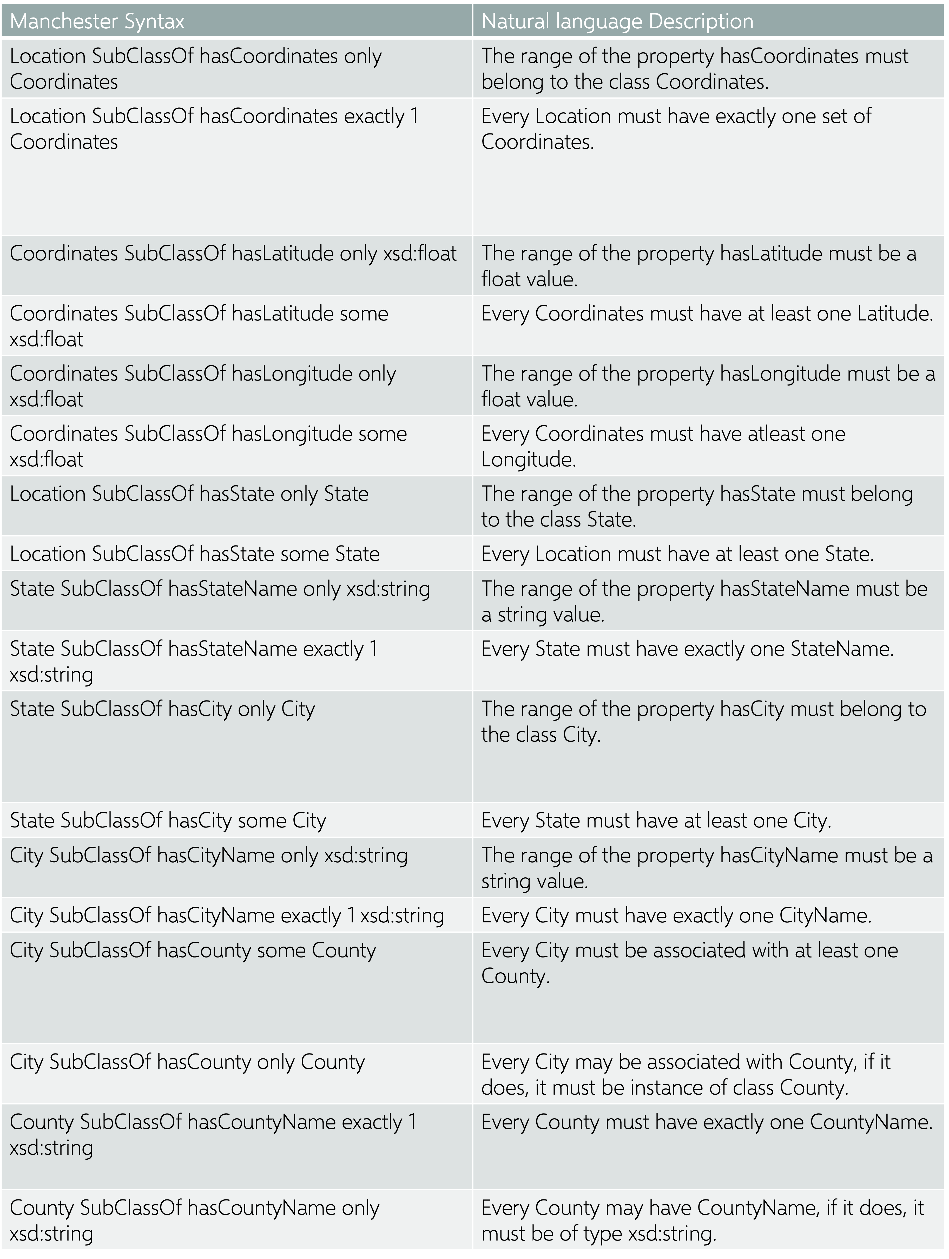
AXIOMS

Slide 17
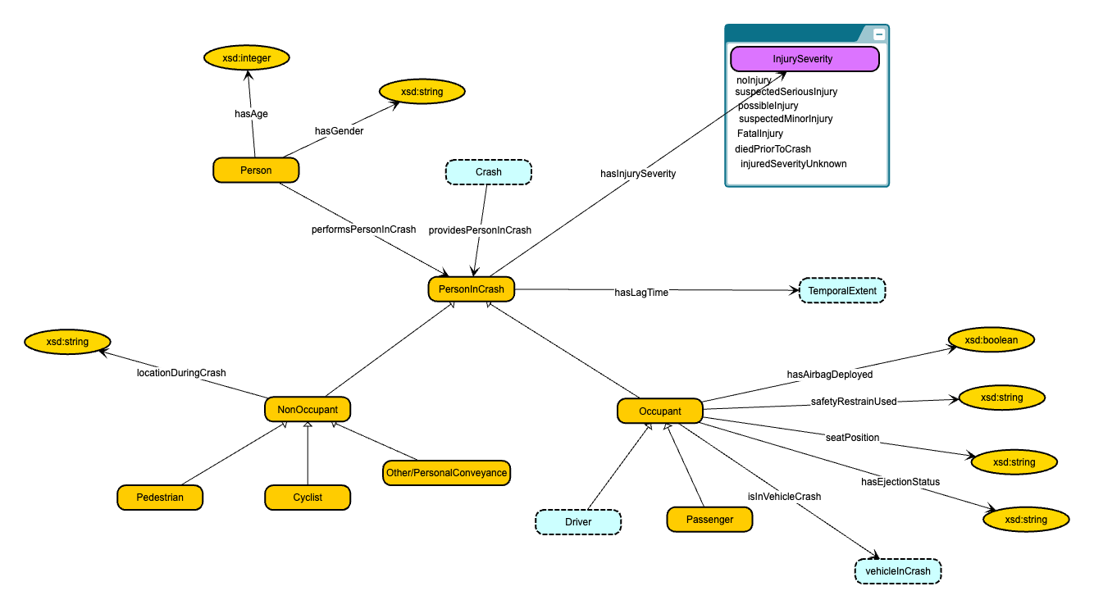
PERSON
The Person module captures details of all individuals involved in crashes, including drivers, passengers, and pedestrians. Attributes like age, gender, and injury severity are modeled to study the human factors influencing crash outcomes.

Slide 18
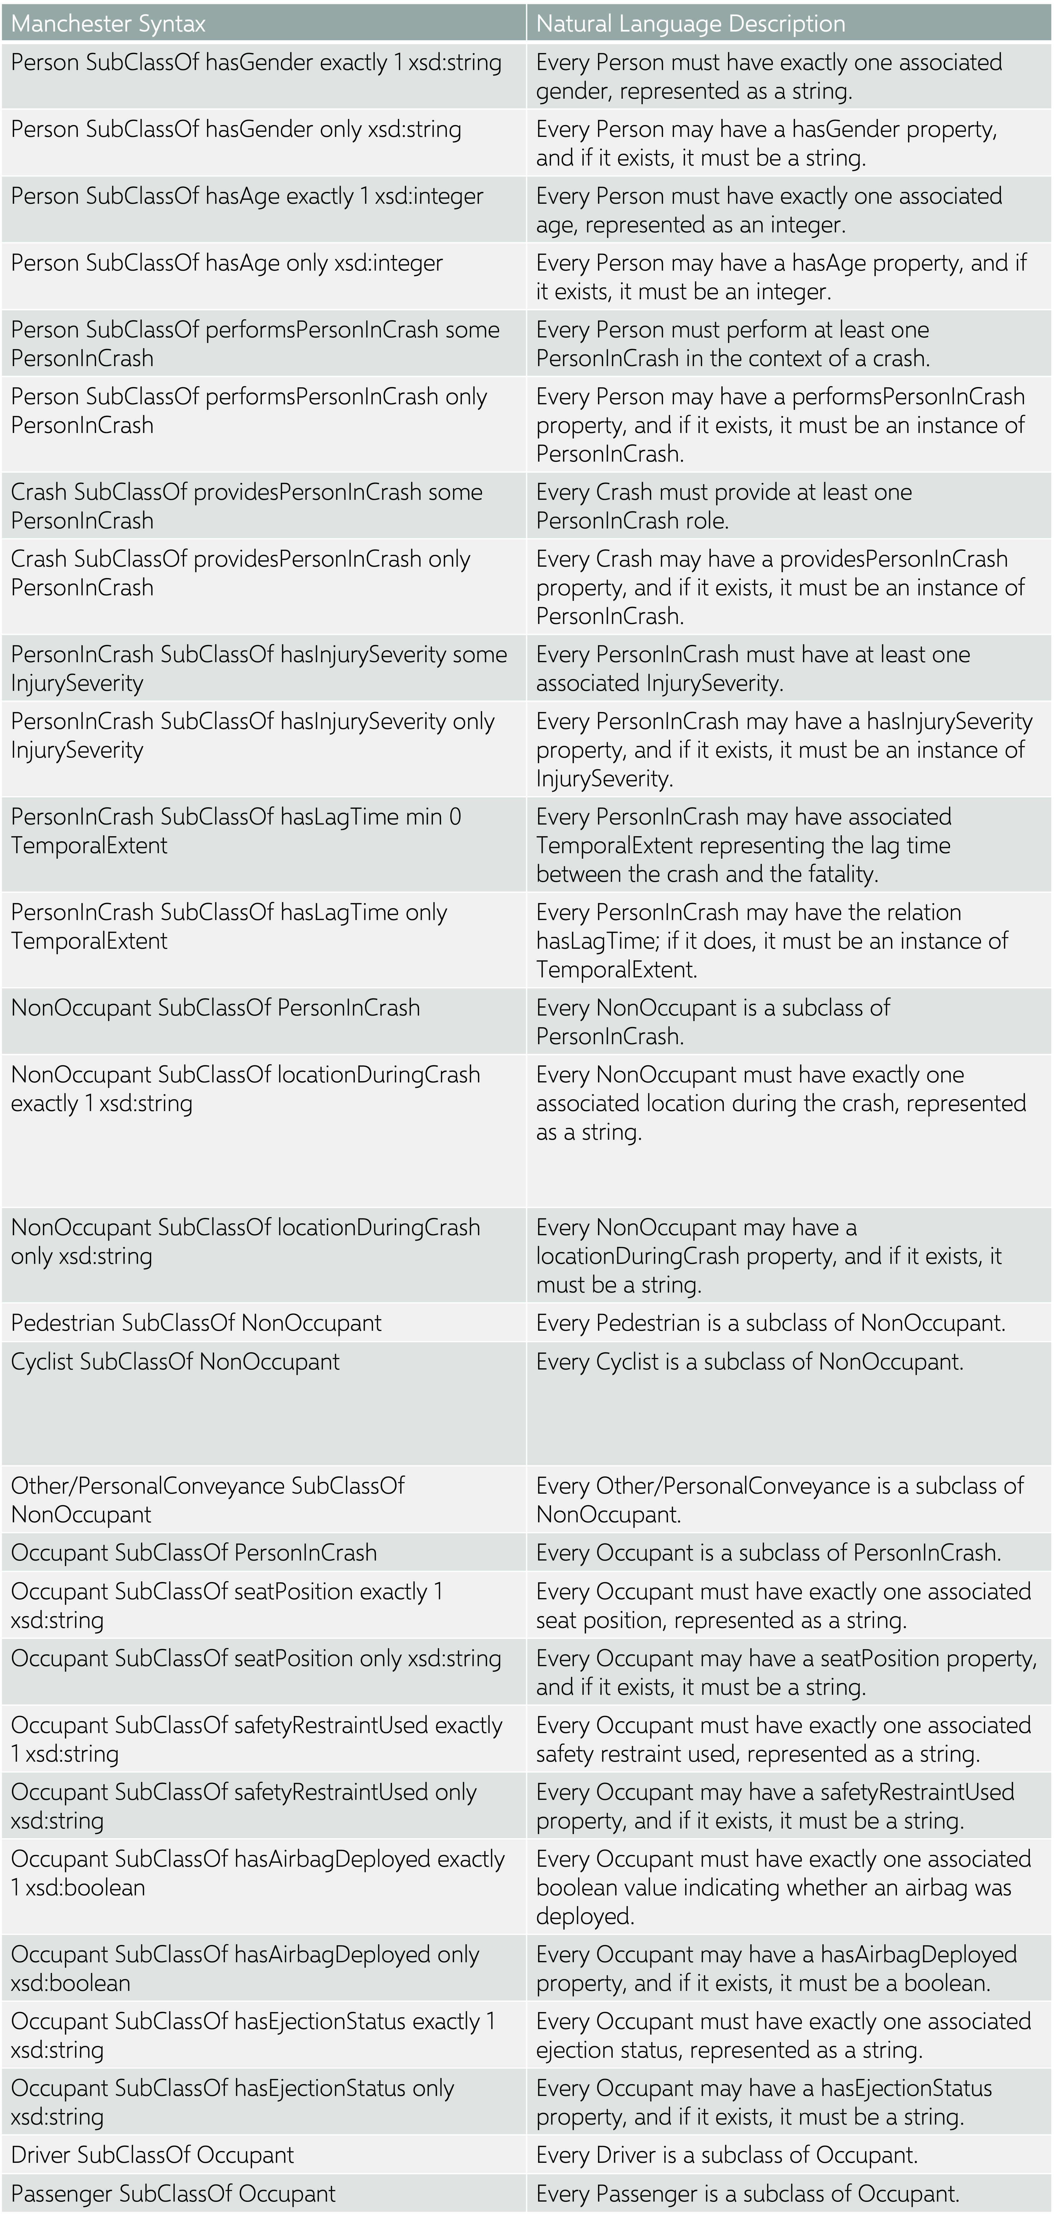
AXIOMS

Slide 19
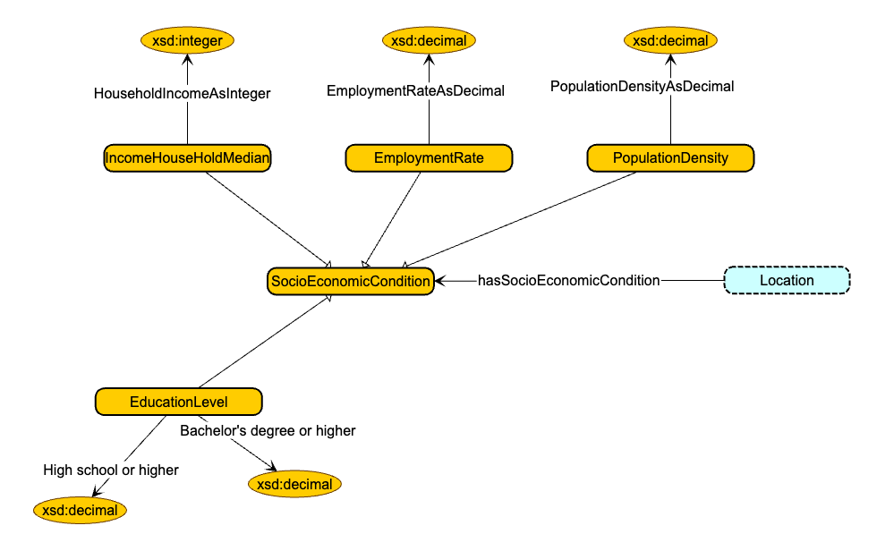
SOCIOECONOMIC CONDITIONS
This module captures regional socioeconomic data, such as household income, education level, employment rates, and population density. It connects these factors to crash events, helping analyze the role of socioeconomic disparities in crash frequency and severity. This information aids policymakers in targeting interventions for high-risk communities.

Slide 20
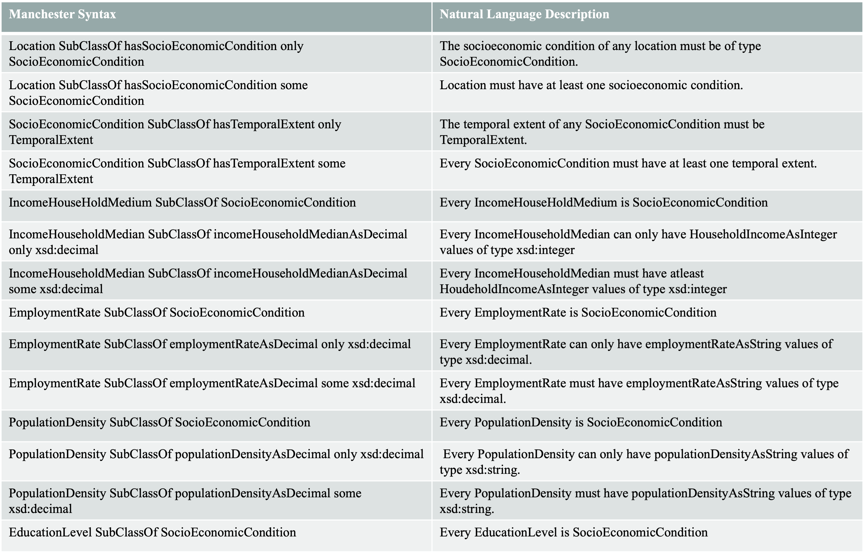
AXIOMS

Slide 21
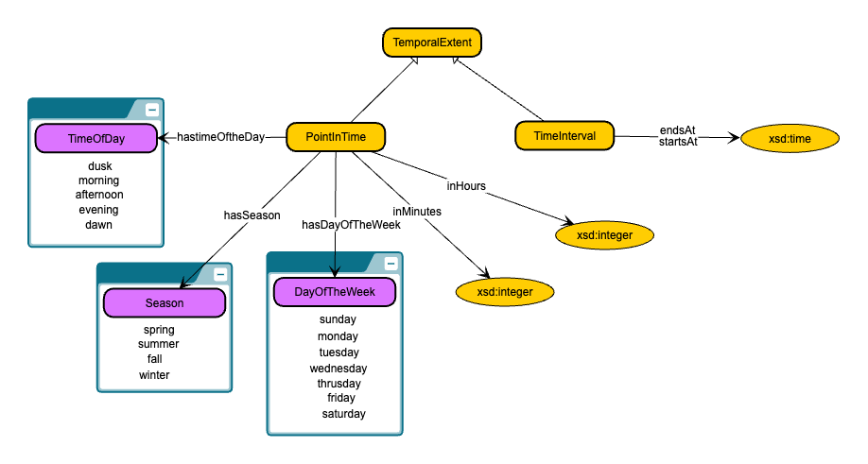
TIME
The Time module represents temporal aspects of crashes, such as time of day, day of the week, and season. It helps identify trends and patterns, like peak crash hours or seasonal variations, enabling time-specific safety measures and interventions.

Slide 22
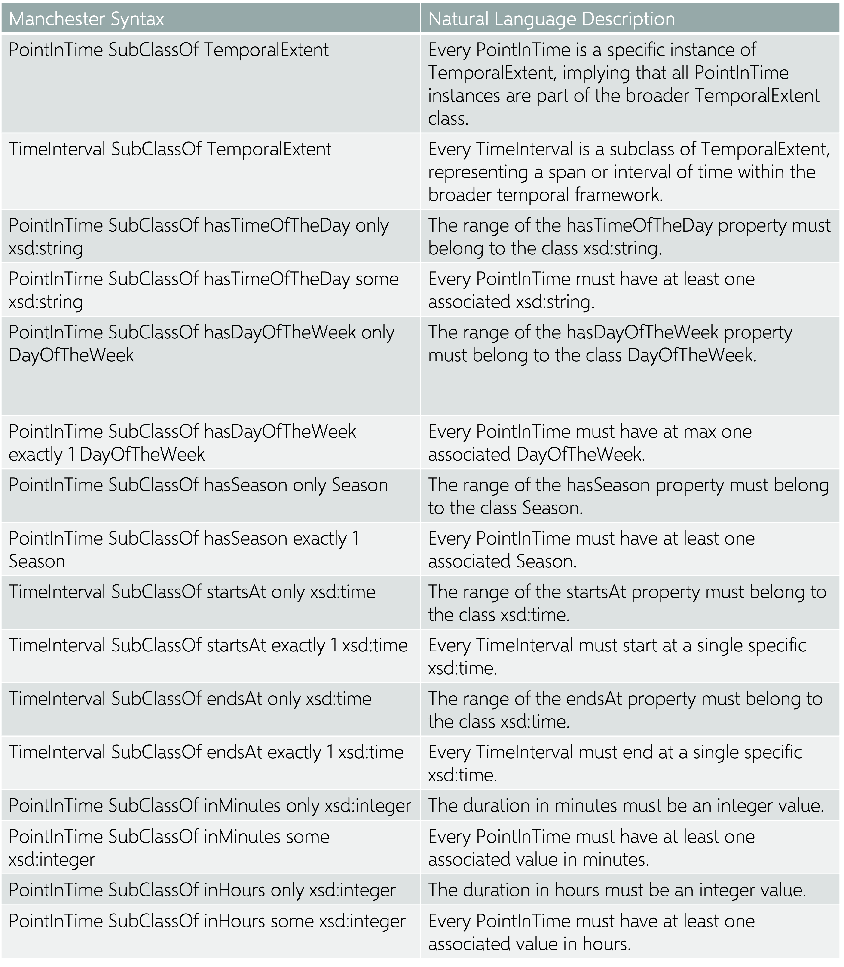
AXIOMS

Slide 23
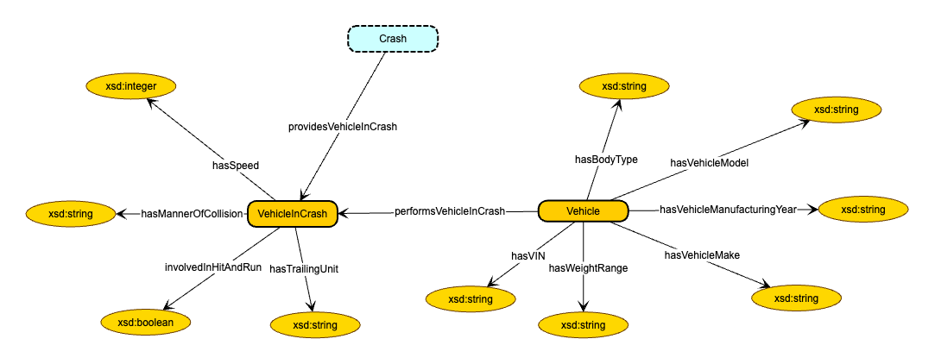
VEHICLE
The Vehicle module captures vehicle-specific data, including make, model, year, body type, and safety features. It also incorporates crash-specific attributes such as the speed at the time of the crash, involvement in a hit-and-run, and trailing units. This module provides insights into the role of vehicle conditions in crash occurrences and outcomes.

Slide 24
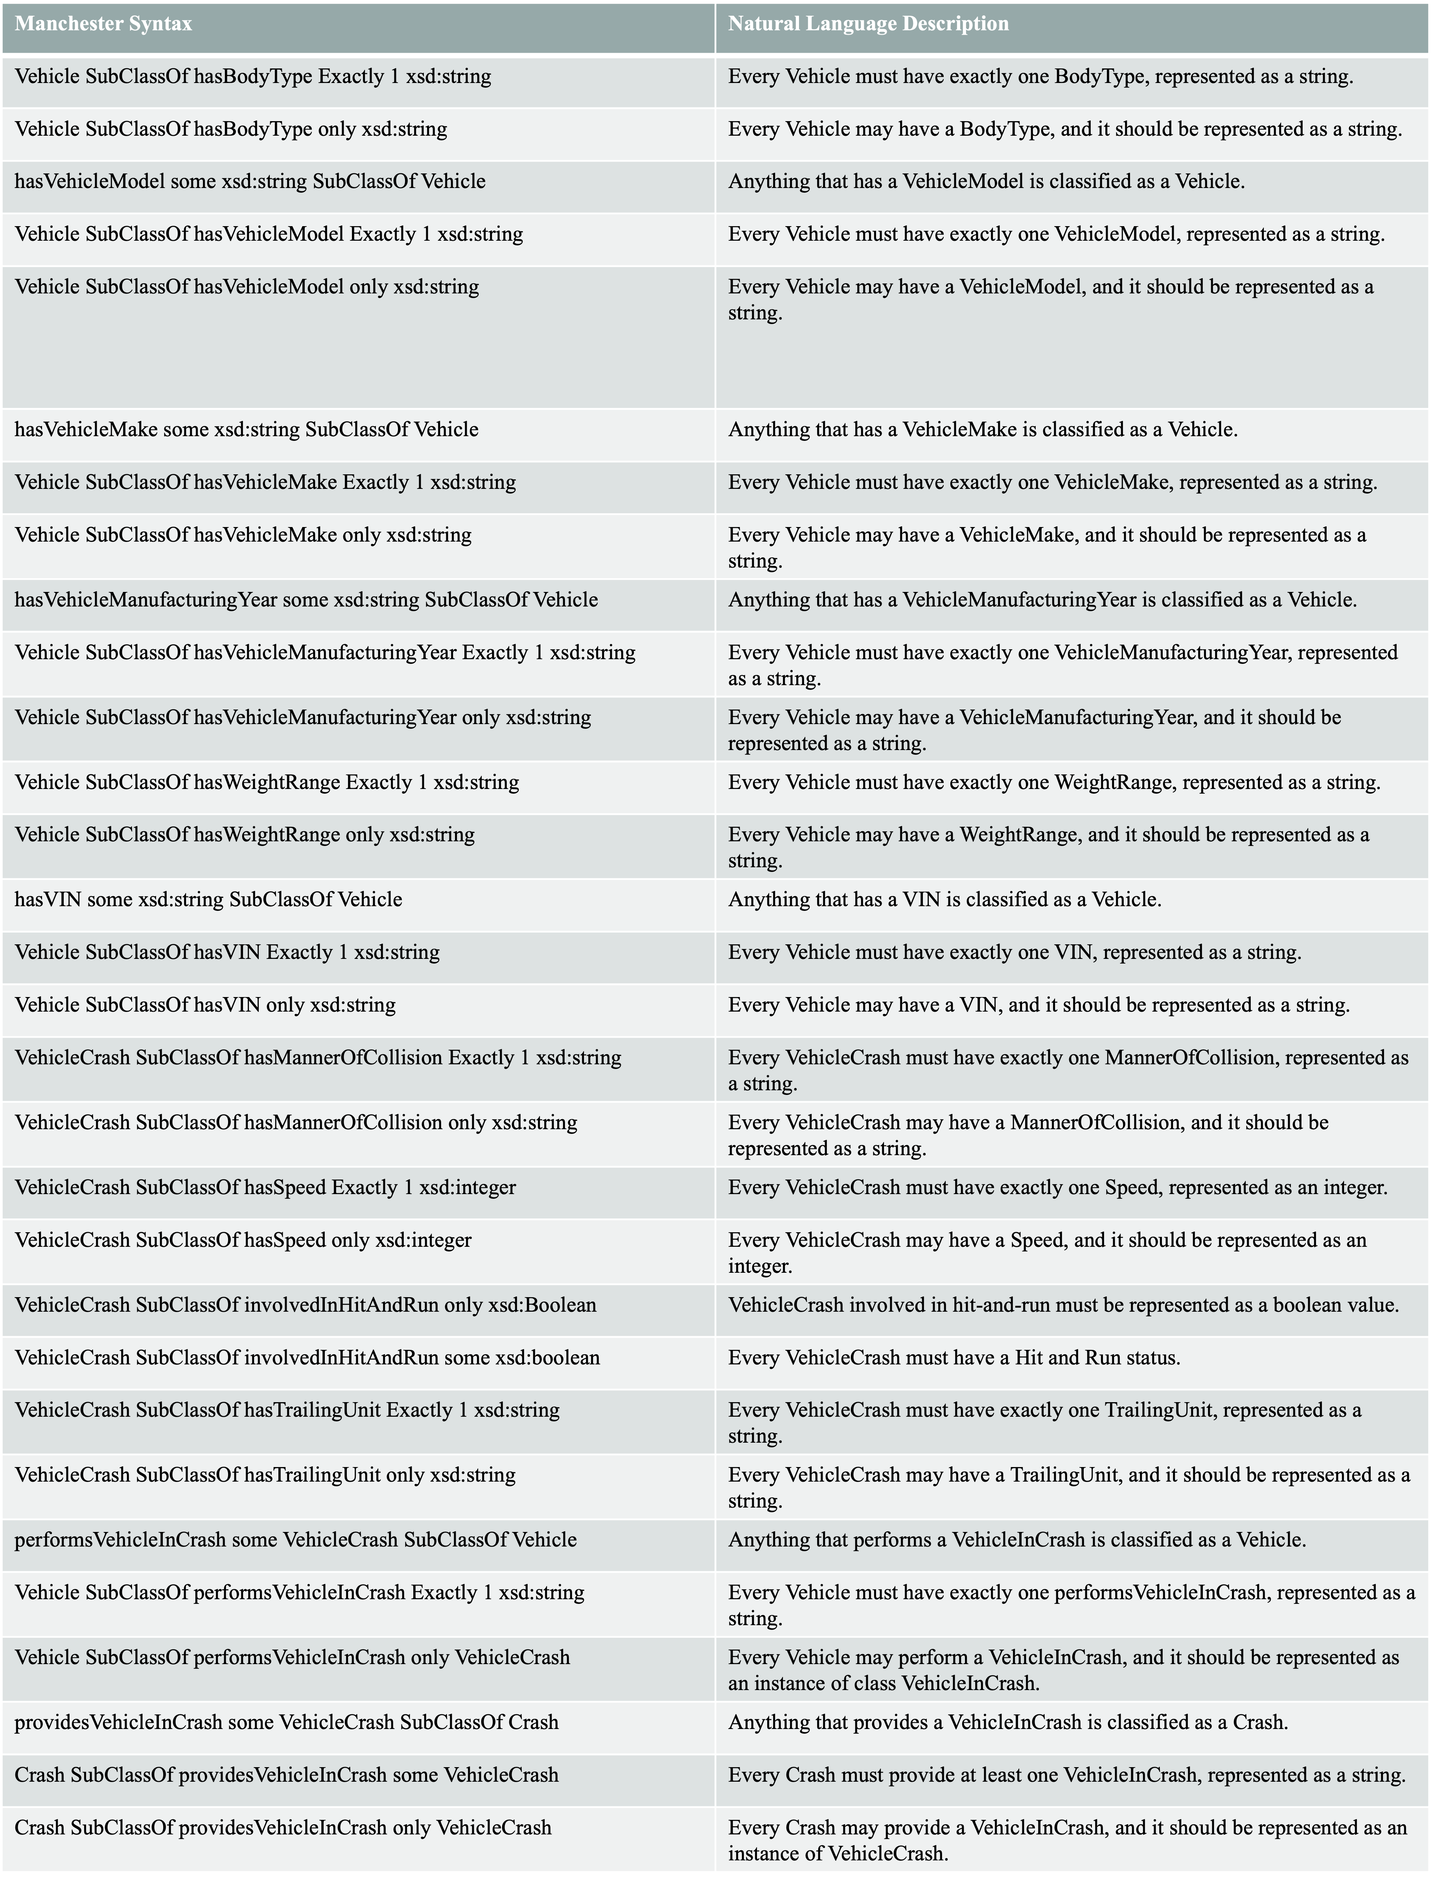
AXIOMS

Slide 25
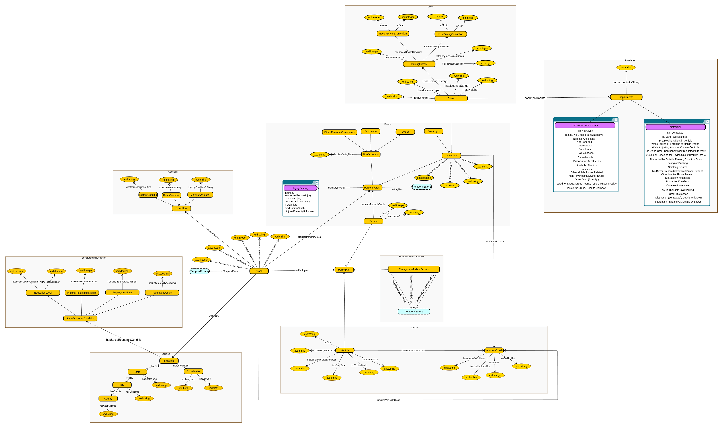
ALL TOGETHER SCHEMA

Slide 26
COMPETENCY QUESTIONS
How do different types of collisions (like head-on or rear-end) and seat positions affect fatality rates?
What patterns can be seen between weather conditions, seasons, and the chances of fatalities in crashes?
How do EMS response times (from being notified to arriving at the crash site and transporting to a hospital) affect survival rates?
How does driver impairment (from alcohol, drugs, or fatigue) impact crash rates?
Which drivers involved in crashes have a history of prior accidents, Driving While Intoxicated (DWI) offenses, or speeding violations, and how do their past records compare?
How do a driver's license status and type relate to the rate of crashes?
How do specific road conditions affect the likelihood and severity of crashes?
How do a state's income levels influence the rate of crashes?
How do driver attributes such as age, sex, weight, and height impact the severity of injuries sustained in road crashes?
How does the speed of the vehicle and age of the occupant during the crash relate to the Fatality?

Slide 27

SPARQL QUERIES

Slide 28
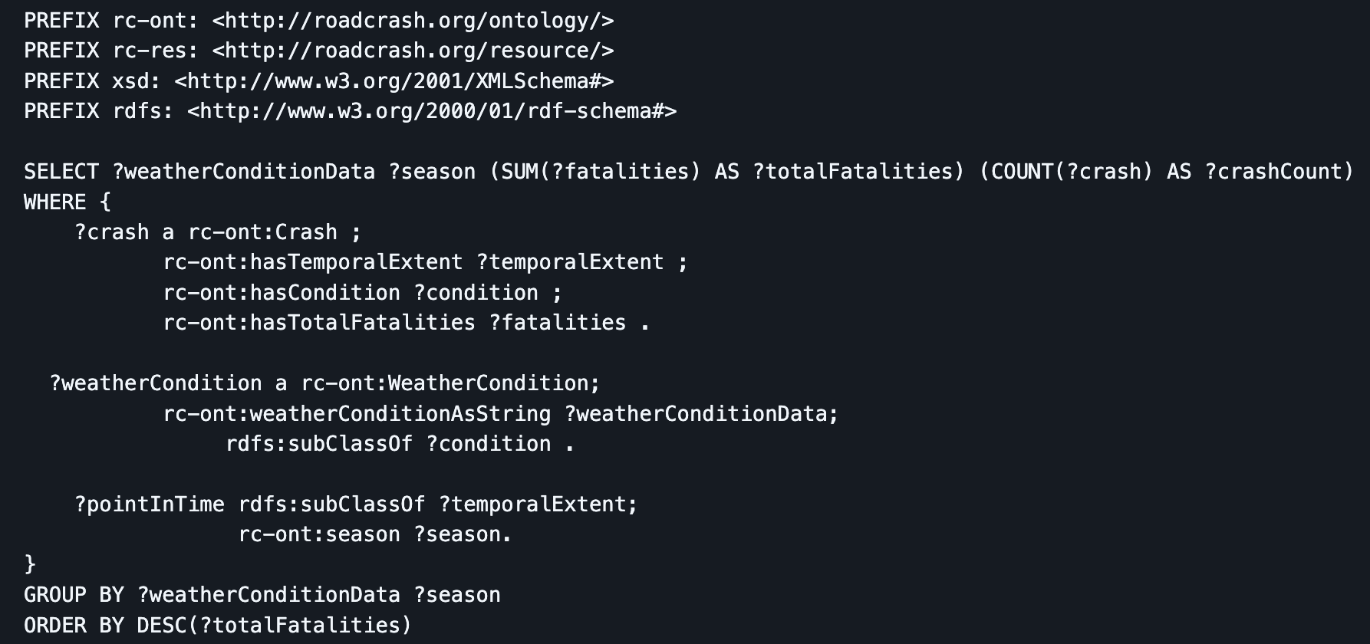
Weather Fatality Patterns
Competency Question: "What patterns can be seen between weather conditions, seasons, and the chances of fatalities in crashes?
Bridged Datasets: Crash.csv, time.csv
SPARQL Query:

Slide 29
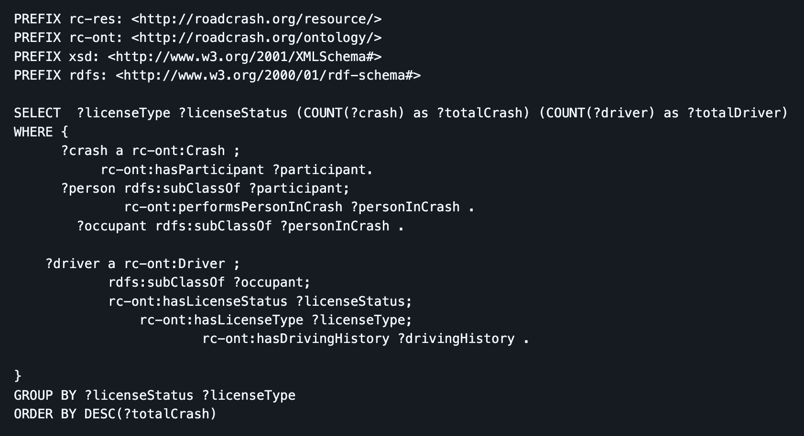
License Status & Crash Rate
Competency Question: " How do a driver's license status and type relate to the rate of crashes?
Bridged Datasets: Crash.csv, Vehicle.csv
SPARQL Query:

Slide 30
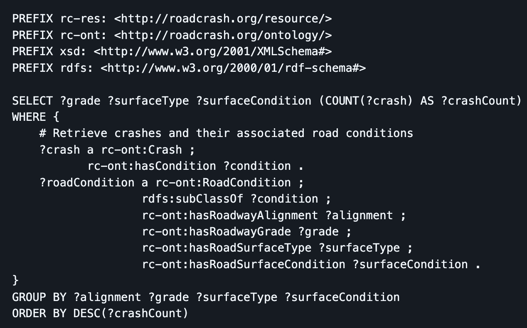
Road Condition Impact
Competency Question: " How do specific road conditions affect the likelihood and severity of crashes?
Bridged Datasets: Crash.csv, Vehicle.csv
SPARQL Query:

Slide 31

DEMO

Slide 32
RETROSPECTIVE
Name | What worked well | Challenges | Suggestions
Sai Sree Korrapati | Breaking tasks into clear milestones ensured steady progress and maintained focus. | Finding and cleaning relevant datasets was challenging and time-consuming. The initial setup and understanding of tools like Apache Jena Fuseki took some effort. | Allocating more time for dataset validation and query optimization would have improved the final results.
Suyes Sapkota | Having thursday updates pushed us to make consistent weekly progress. | Multiple iterations of schema diagrams and axioms. | Briefly discuss why and when to use knowledge graphs for managing and querying data, compared to tools like RDBMS, data warehouses, and data lakes, using real-world scenarios.
Ruman Dangal

Slide 33

THANK YOU

